Slide 1



Session 3.1: Query Transformations
& The Limitations of Naive RAG
Moving from brittle, prompt-dependent retrieval systems to intelligent, resilient AI middleware.

Slide 2




Session Agenda
1. The "Naive RAG" Ceiling
4. Step-Back Prompting
Understanding the "Garbage In, Garbage Out" rule of Cosine Similarity and the catastrophic failures of basic RAG.
The DeepMind Solution: Retrieving high-level, foundational context for hyper-specific, zoomed-in edge cases.
2. Query Routing
5. HyDE Architecture
Building the "Traffic Cop." Using LLMs to dynamically route user questions to specialized tools (Vector DB vs. Math Calculator).
Hypothetical Document Embeddings: Weaponizing hallucination to bridge the semantic gap, and assessing its risks in strict pipelines.
3. Query Decomposition
6. Masterclass Lab
Shattering the "Multi-Headed Hydra." Splitting complex queries into parallel vector searches using the MultiQuery Strategy.
Upgrading our standard LCEL chain with RunnableBranch to deploy advanced middleware transformations.

Slide 3



The "Naive RAG" Ceiling
In Week 2, we built a fully functional RAG pipeline. When a user asks a perfectly articulated question, the FAISS database retrieves the chunks, the Mega-Prompt grounds the LLM, and Gemini answers flawlessly.
The Assumption
The Harsh Reality
Naive RAG mathematically assumes that the user will always ask perfectly structured, highly articulate, single-intent questions.
In the real world, human users are lazy, vague, and chaotic. They do not think about vector embeddings before typing a message.
A robust MLOps pipeline must protect the database from the user.

Slide 4



The Rule of Vector Search
Cosine Similarity is Blind
In Session 2.1, we established that FAISS relies on Cosine Similarity. It translates a prompt into a 768-dimensional vector and searches for the closest neighborhood.
The Fatal Flaw: Embedding models do not "think." They are purely mathematical algorithms.
Garbage In,
Garbage Out
You cannot fix a bad database query in the final LLM prompt. The data is already lost.
Terrible User Prompt → Terrible Mathematical Vector.
Terrible Vector → FAISS retrieves irrelevant chunks.
Irrelevant Chunks → LLM hallucination or a failed answer.

Slide 5





Failure 1: The Pronoun Drop
Users naturally converse with AI as if it were a human with memory. They use conversational vagueness.
it
SYSTEM CRASH

Slide 6


Why The Pronoun Drop Fails
The Mathematical Result
The Vector Mechanics
Because the isolated string contains zero keywords related to "OCR," "documents," or "PDFs," the Cosine Similarity math goes rogue.
The user assumes the AI remembers the OCR context. However, FAISS does not have memory.
The pipeline blindly embeds the literal string:
"How do we fix it?"
FAISS retrieves a chunk about fixing bugs in the UI.
FAISS retrieves a chunk about fixing the budget deficit.
The pipeline completely fails to answer the user's actual intent.

Slide 7





Failure 2: The Multi-Headed Hydra
Users frequently attempt to optimize their time by asking massive, multi-intent complex queries in a single breath.
The User Prompt

Slide 8


The Math of the Hydra
The "Dead Zone" Averaging
The embedding model attempts to calculate a single 768-dimensional vector that represents the average mathematical meaning of "Author," "OCR," and "Budget."
The Retrieval Failure
It is not physically close enough to the Author chunks.
This averaged vector lands in a complete "Dead Zone" in the high-dimensional vector space.
It is not close enough to the OCR metric chunks.
It is not close enough to the Financial chunks.
Result: FAISS retrieves an irrelevant middle-ground chunk, satisfying none of the user's intents.

Slide 9



Failure 3: Domain Mismatch
Users routinely confuse the capabilities of a Vector Search Engine with the capabilities of a Calculator or SQL Database.
The Retrieval Crash
The User Prompt
Naive RAG blindly routes this mathematical request directly to the FAISS text database.
FAISS searches for chunks containing vectors related to the words "calculate," "scale," and "15%". It fails to find the answer because the answer requires live computation, not semantic text retrieval.

Slide 10


The Solution: Middleware
Query Transformations
If we cannot trust the user to write perfect prompts, we must fix their prompts for them, invisibly, before the vector database ever sees them.
The "Traffic Cop" LLM
Instead of wiring the user directly to FAISS, we place a lightweight LLM (the Traffic Cop) in front of the database.
This introduces a powerful new architectural layer into our LCEL pipeline: The AI Middleware.
Reads the messy query.
Restructures vague pronouns using chat history.
Breaks apart multi-headed questions.

Slide 11










Architectural Evolution
Week 2: Naive RAG Architecture
Direct connection. Fragile against bad inputs.
Week 3: Advanced RAG Architecture (Relay Race)
(Transforms Query)
(Generates Answer)
Microservice approach. Intelligent routing and query sanitization.

Slide 12






The Multi-Tool Ecosystem
In Week 2, we built a linear chain: Prompt → LLM → Parser. But in real-world projects like "Extract Once, Judge Many," users don't just ask about text PDFs. They query a massive web of specialized tools.
FAISS Vector Database
SQL Relational Database
Perfect for semantic, textual queries: "What is the company policy on remote work?"
Perfect for hard, relational metrics: "List all employees who joined the engineering team in Q3."
Python REPL / Calculator
General Chit-Chat Chain
Perfect for strict computation: "If we increase the $45k budget by 12%, what is the new total?"
Handles standard greetings: "Hello, how are you?" without wasting expensive vector database search credits.

Slide 13



The Routing Problem
The Inevitable Crash
If you wire a user's prompt directly into FAISS, and they ask a complex math question, the system crashes.
FAISS will blindly search for the semantic words "increase," "budget," and "12%." It will fail to return a computed mathematical answer.
The Solution: The Traffic Cop
Intercept → Assess → Route
We must build an intelligent Router that intercepts the query, assesses its semantic intent, and flips a switch to send the data down the correct specialized pipeline.

Slide 14





Two Architectures of Routing
A senior MLOps engineer must master both routing architectures and know exactly when to deploy them based on latency constraints and query complexity.
1. Logical Routing
2. Semantic Routing
Uses a smaller, fast LLM (like Gemini 3 Flash) purely as a classification engine.
Uses raw Cosine Similarity math and pre-computed exemplar vectors to bypass the LLM entirely.
Pro: Deep reasoning. Can understand extreme nuance.
Con: Introduces generation latency.
Pro: Blistering, sub-second speed.
Con: Struggles with highly ambiguous or tricky language.

Slide 15


Logical Routing (LLM-as-Classifier)
The Gatekeeper Concept
We do not ask this LLM to answer the user's question; we ask it to strictly categorize the question.
The Benefit of Reasoning
Because it utilizes the Transformer architecture, it can parse incredibly complex intent.
We write a highly specific, few-shot prompt.
"Calculate the variance between the Q3 audit report and the Q4 audit report."
We combine it with Pydantic structured output (from Session 1.2).
A simple keyword router might send this to the Math tool because of "Calculate." A logical LLM realizes it needs to read the reports first, routing it to FAISS.
We force the LLM to return a single, hardcoded string.

Slide 16

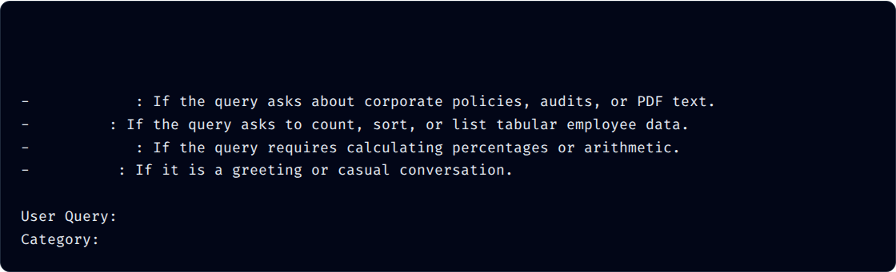
The Logical Router Prompt
By forcing the LLM to select from a strict list, we guarantee predictable routing behavior.
System: You are an expert routing classification algorithm.
Read the user's query and classify it into one of the following exact categories:
"vector_db"
"sql_db"
"math_tool"
"general"
{query}

Slide 17


The Latency Trade-off
Logical routing guarantees incredible accuracy, but it introduces Sequential Latency. By placing an LLM in front of the database, you add 500ms to 1.5 seconds of "dead time" before the actual work even begins.
The Architect's Dilemma
In the 'Extract Once' pipeline, enterprise data is highly complex. We gladly trade 1 second of latency for absolute accuracy to distinguish between a request to read a budget (Vector DB) versus calculating a new budget (Math Tool).

Slide 18


Semantic Routing (Supersonic Switch)
Bypassing the LLM
If your application requires blistering, sub-second speed, you cannot wait for an LLM to generate text. You must use Semantic Routing.
The Execution Speed
Because it relies on vector distance calculation (an $O(1)$ lookup in optimized space), it executes in <50 milliseconds.
Instead of neural network generation, it uses the raw Cosine Similarity math we learned in Session 2.1.
It completely removes Latency_Router_LLM from the pipeline equation.

Slide 19




Semantic Routing Mechanics
1. Define Exemplars
2. Pre-Embed
3. Compute Distance
Manually define list of example queries per route.
Math: ["Calculate sum", "Multiply"]
FAISS: ["Read report", "Audit"]
Convert all exemplars into high-dimensional vectors ahead of time and store them in memory.
Instantly embed user query. Calculate Cosine Similarity against all exemplars. Route to the closest mathematical match.

Slide 20
Architectural Comparison
Feature | Logical Routing (LLM) | Semantic Routing (Vectors)
Mechanism | Generative Reasoning / Few-Shot Prompt | Cosine Similarity / Exemplar Distance
Latency | High (500ms - 1.5s) | Blistering (<50ms)
Nuance Handling | Excellent (Understands complex intent) | Moderate (Fails on highly ambiguous language)
Cost | High (Burns Generation API Tokens) | Low (Only burns Embedding API Tokens)

Slide 21



Wiring the Router in LCEL
Introducing RunnableBranch
LangChain provides a specialized module explicitly designed to handle conditional logic inside a declarative pipeline.
Think of RunnableBranch as a massive if / elif / else statement built directly into your data flow.
Dynamic Data Flow
Dynamically flips tracks based on data properties.
Route execution without breaking the chain.
Preserves the seamless | pipe operator architecture.

Slide 22


RunnableBranch Mechanics
When you configure a RunnableBranch, you pass it tuples containing exactly two things:
1. The Condition
2. The Target Chain
A simple Python function (like a lambda) or a Runnable that evaluates to strictly True or False.
The specific, specialized LCEL pipeline to execute if the condition evaluates to True.
The final argument is always the Default Fallback Chain (the "else" block).

Slide 23

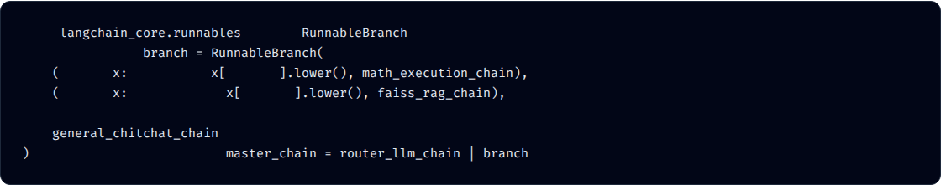
Conceptual Pipeline Architecture
from
# Assuming an upstream LLM outputs "math", "vector", or "general" into x["topic"]
import
lambda
"math"
in
"topic"
lambda
"vector"
in
"topic"
# The default fallback chain if no conditions are met
# The Full Pipeline Flow
The illusion of magic: The user types into one single box, and the AI autonomously figures out which backend system to query.

Slide 24

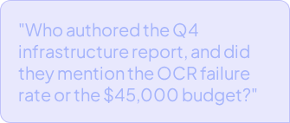
The Multi-Headed Hydra
The Real-World Prompt
The Complexity of Human Prompts
We built a Router to send FAISS queries to FAISS. But what if the query belongs in FAISS, but it is an absolute mess of overlapping requests?
This query demands three completely different pieces of semantic information simultaneously.
To a human: One cohesive thought.
To a Vector Database: A mathematical disaster.

Slide 25



The Math of Semantic Dilution
When the embedding model reads the Hydra prompt, it generates a single 768-dimensional vector. Because the prompt contains three distinct concepts, the neural network calculates the average of those three semantic directions.
The "Dead Zone"
Retrieval Failure
This "averaged" vector does not point directly at the Author chunk, nor the OCR chunk, nor the Budget chunk. It points to an empty void in the middle of the hypersphere.
FAISS Cosine Similarity will return chunks that vaguely mention "Q4", completely missing the highly specific numbers required to answer the prompt.

Slide 26




The Solution: Query Decomposition
We cannot train the user to ask three separate questions. Therefore, we must build a system that intercepts the prompt and splits it for them.
Sub 1: "Who wrote the Q4 audit?"
Raw Query
Fast LLM
"Who wrote the Q4 audit, what's the OCR rate, and what's the budget?"
Executes decomposition prompt to split intents.
Sub 2: "What is the OCR rate?"
Sub 3: "What is the Q4 budget?"

Slide 27
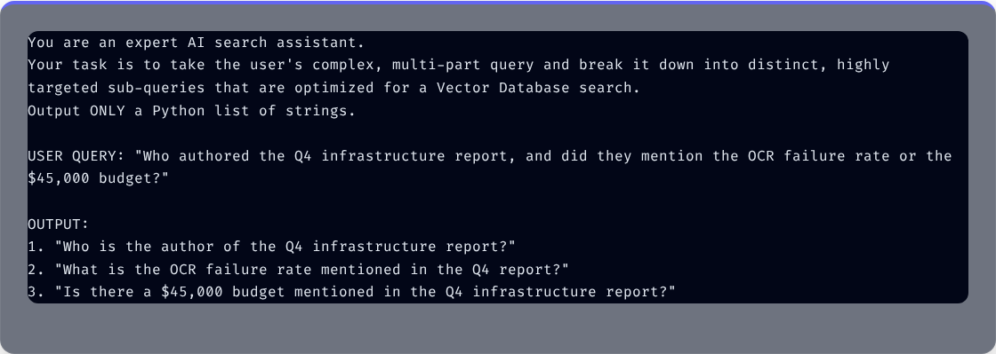
The Decomposition Prompt
We pass the raw user query to a blazing-fast LLM (like Gemini 3 Flash) with a very specific set of system instructions to generate an actionable list.

Slide 28


Parallel Execution & Deduplication
1. Parallel Embedding & Search
LangChain simultaneously sends all three strings to the Embedding API. We now have three hyper-focused, razor-sharp vectors.
2. Deduplication
What if Search 1 and Search 2 accidentally retrieve the exact same paragraph?
Search 1 finds the Author chunk.
LangChain automatically inspects the Document objects and uses their unique content hashes to remove duplicates.
Search 2 finds the OCR chunk.
Search 3 finds the Budget chunk.
This ensures the final LLM isn't wasting its context window reading the exact same paragraph twice.

Slide 29



The MultiQueryRetriever
Out-of-the-Box Orchestration
You do not need to manually write the threading logic to execute three simultaneous database searches. LangChain provides a beautiful abstraction.
The MultiQueryRetriever wraps around your base FAISS retriever. You pass it an LLM (the "Traffic Cop"), and it handles the decomposition, the parallel execution, and the content hash deduplication entirely under the hood.
1 Line of Code
Replaces hundreds of lines of complex concurrent Python execution.

Slide 30

Code Implementation: MultiQueryRetriever
from langchain.retrievers.multi_query import MultiQueryRetriever # 1. Initialize the "Traffic Cop" LLM and Base FAISS Retriever llm = ChatGoogleGenerativeAI(model="gemini-3.1-flash", temperature=0.0) base_retriever = vectorstore.as_retriever(search_kwargs={"k": 2}) # 2. Wrap the Base Retriever to unlock Decomposition advanced_retriever = MultiQueryRetriever.from_llm( retriever=base_retriever, llm=llm ) # 3. Execute the Multi-Query Search (Decomposes, Searches, Deduplicates automatically) complex_query = "Who wrote the Q4 audit, and what did they say about OCR and the $45k budget?" retrieved_docs = advanced_retriever.invoke(complex_query) print(f"Total Unique Documents Retrieved: {len(retrieved_docs)}")
from
import
# 1. Initialize the "Traffic Cop" LLM and Base FAISS Retriever
"gemini-3.1-flash"
0.0
as_retriever
"k"
2
# 2. Wrap the Base Retriever to unlock Decomposition
from_llm
# 3. Execute the Multi-Query Search (Decomposes, Searches, Deduplicates automatically)
"Who wrote the Q4 audit, and what did they say about OCR and the $45k budget?"
invoke
print
f"Total Unique Documents Retrieved: {len(retrieved_docs)}"

Slide 31

The MLOps Trade-off
The Cost (Tokens & Latency)
The Enterprise Value
Requires an extra LLM call every single time the user hits search.
In MLOps, we gladly pay fractions of a penny for extra API tokens if it means preventing a catastrophic hallucination.
Hits the Embedding API 3-4 times instead of once.
A "diluted" search returns nothing. A decomposed search returns the exact metrics required to make a multi-million dollar corporate decision safely.
Increases total pipeline latency.

Slide 32



The Ranking Problem
When you pull documents from three different sub-queries, how do you decide which one is the most important to feed to the final Prompt?
LangChain's default MultiQueryRetriever simply lumps them all together into a deduplicated list.
But what if Chunk A appears in Sub-Query 1's results AND Sub-Query 3's results? That means Chunk A is highly relevant to multiple parts of the user's complex question.
Cross-Query Priority
We need a way to mathematically push chunks that answer multiple intents to the very top of the list.

Slide 33


Reciprocal Rank Fusion (RRF)
RRF is the Senior Architecture solution. It is a mathematical algorithm that calculates a composite score based on the rank of a document across multiple sub-queries.
Sub-Query 1 Results
Sub-Query 2 Results
Sub-Query 3 Results
1. Chunk A
1. Chunk D
1. Chunk B
2. Chunk C
2. Chunk E
2. Chunk A
RRF Master List
#1: Chunk A (Appeared Twice!)
Guarantees that chunks answering multiple parts of the hydra-query are prioritized over chunks answering one tiny detail.

Slide 34



The "Zoomed-In" Problem
The Assumption of Perfect Documentation
As an MLOps engineer, you will quickly discover a fatal flaw in how humans interact with Retrieval-Augmented Generation systems.
Users often ask questions that are incredibly "zoomed in." They ask about highly specific, isolated edge cases, mathematically assuming that the enterprise database contains a perfect, pre-written paragraph answering that exact scenario.
Hyper-Specificity
Narrow queries blind the retrieval engine.

Slide 35





The Real-World Enterprise Example
Consider this highly realistic prompt submitted by an executive investigating a pipeline failure:
Entity 1
Entity 2
Entity 3
European Division
Legacy Branch Offices
Tuesday Review

Slide 36


The Vector Failure Mechanics
Missing the Obvious
Mathematical Tunnel Vision
The database does have a highly relevant chunk titled "Standard Operating Procedure for OCR," which clearly states that low DPI scans cause failures.
When you embed Marten's hyper-specific question, the resulting 768-dimensional vector becomes extremely narrow. The Cosine Similarity algorithm frantically searches FAISS for chunks containing "European division," "legacy branches," and "Tuesday."
Because the prompt was so specific, its vector mathematically moved away from the general SOP chunk. FAISS returns zero relevant results.
The Problem: The database does not have a chunk that mentions all those specific details together.

Slide 37



The DeepMind Solution
Brilliant Simplicity
Before you try to answer a highly specific, complex question, you should first "take a step back" and ask a foundational, high-level question about the underlying principles.
Published Late 2023
Intercept the user's specific query.
Google DeepMind introduces Step-Back Prompting.
Use a specialized LLM to generate a broader, generalized version.
Search the database for the generalized rules.

Slide 38

Translating to a Step-Back Query
We insert a specialized "Traffic Cop" LLM into the pipeline. We ask this LLM to read the query and strip away the hyper-specific entities.
Original Specific Query (From User):
Generated Step-Back Query (From LLM):

Slide 39



Parallel Retrieval Architecture
Once the LLM generates the Step-Back query, the LCEL pipeline splits into a powerful dual-track architecture:
Search Track A
Search Track B
Input: Original Query
Input: Step-Back Query
FAISS executes a search hunting for specific details about the European division and Tuesday reviews.
FAISS executes a parallel search hunting for the foundational rules of OCR failures (The SOP docs).

Slide 40



Synergistic Generation
Connecting the Dots
Both sets of documents are retrieved, combined, and deduplicated. We then inject this massive, comprehensive context into the final Mega-Prompt.
The Result
The LLM connects the general rule to the specific fact, providing a flawless, highly reasoned answer impossible with Naive RAG.
Foundational Rules: "Low DPI causes failures."
Specific Context: "Europe uses legacy scanners."

Slide 41

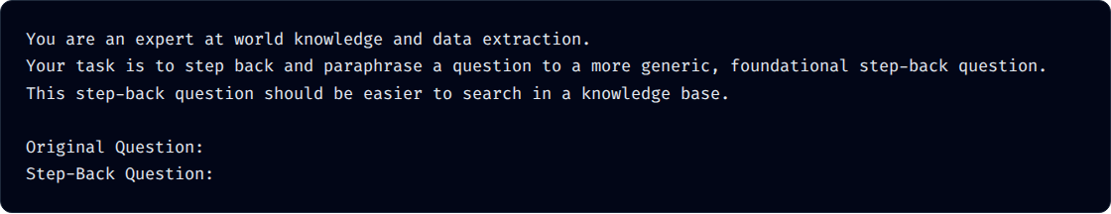
Step-Back Prompt Engineering
We explicitly command the LLM to strip away the hyper-specific details using a dedicated Prompt Template.
{question}
The LCEL Generator Chain:

Slide 42

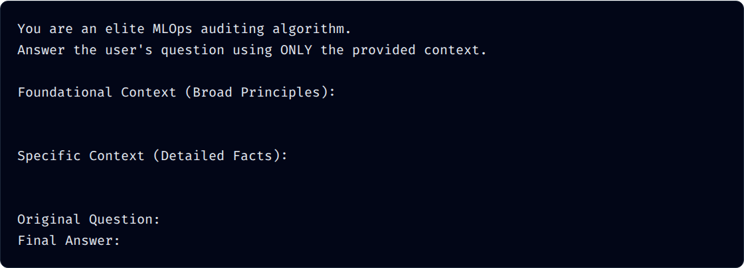
The Dual-Context Mega-Prompt
Notice how this final prompt template now accepts TWO entirely different context variables injected simultaneously.
{step_back_context}
{normal_context}
{question}

Slide 43

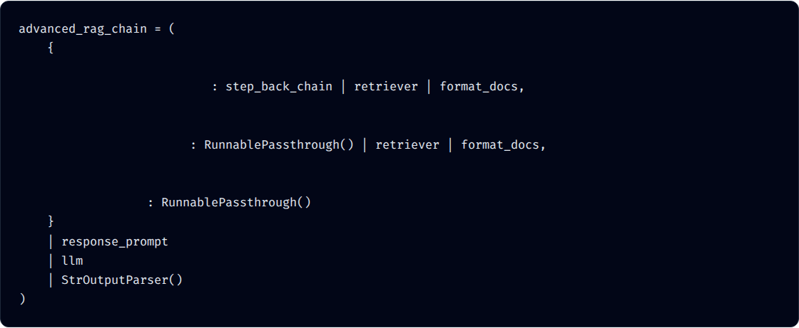
LCEL Parallel Data Flow
Wiring this parallel architecture in standard Python takes dozens of lines of code. In LCEL, it is handled via an elegant dictionary mapping.
# A) Hits step_back_chain -> broad question -> retriever
"step_back_context"
# B) Original query -> skips step_back -> hits retriever directly
"normal_context"
# C) Passed through completely untouched
"question"

Slide 44


The MLOps Reality Check
The Trade-offs
Token Consumption: Executing TWO full LLM calls and TWO distinct FAISS searches per query.
A PhD in Reasoning
Step-Back Prompting essentially gives your pipeline a PhD in reasoning. It bridges the gap between general principles and specific instances flawlessly.
Latency: Adding a sequential generative step before retrieval adds roughly 800ms to 1.5 seconds of delay.
But it comes with a cost.

Slide 45

When to Deploy
When to Use
When to Avoid
When absolute, undeniable accuracy on complex domain knowledge is required.
When speed is prioritized over deep reasoning.
Customer Service Chatbots
Legal Audits
Basic FAQ Search
Medical Records Analysis
E-commerce Product Discovery
Strict Financial Compliance

Slide 46


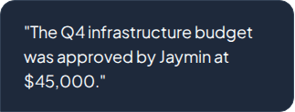

The Semantic Gap
The Document (Declarative)
Questions vs. Answers
As an MLOps engineer, you must understand the fundamental difference between the geometry of a Question and the geometry of an Answer.
The Prompt (Interrogative)
In a standard FAISS database, your chunks are declarative statements. Your user's prompt is interrogative.

Slide 47



Geometric Mismatch
Different Neighborhoods
Because embedding models map meaning and grammar, a short, interrogative question does not always mathematically align with a long, highly descriptive paragraph.
The Void
If the user's question is too short or vaguely worded, its vector will fall short of the target document, landing in the empty "semantic gap."
The Fall Short: They exist in slightly different semantic "neighborhoods" within the 768-dimensional hypersphere.

Slide 48



The HyDE Breakthrough
Semantic Bridging
Researchers invented HyDE to build a bridge across the interrogative/declarative gap.
Instead of embedding the user's short question and hoping it reaches the document, we force an LLM to generate the document we wish existed, and we search using that!
Late 2022
Hypothetical Document Embeddings
We weaponize AI hallucination as a search tool.
We discard the user's prompt entirely during retrieval.

Slide 49




The 4-Step Architecture
1. Intercept
2. Hallucinate
3. Embed
4. Search
The system intercepts the user's short question: "Who approved the budget?"
A fast LLM is told: "Write a hypothetical document answering this." It makes up fake facts.
We discard the user query. We embed the Fake Document into a 768D vector.
We use the Fake Document Vector to search FAISS and retrieve the real documents.

Slide 50



The Magic of the Fake Document
Why does a hallucination work?
The Homing Missile
The LLM doesn't know the real facts, so it makes them up. But it writes them in the exact same declarative, corporate tone as your real documents!
Even though the facts ($100k vs $45k) are completely wrong, the semantic structure of the fake document mathematically perfectly aligns with the real documents.
The Hallucination:
It acts as a homing missile, crossing the semantic gap and pulling back the real chunks with stunning accuracy.

Slide 51


The MLOps Warning
When NOT to use HyDE
HyDE is practically magic for broad, exploratory searches (e.g., "How does this company handle remote work?").
But it is highly dangerous for the "Extract Once, Judge Many" project.
Danger Zone
Do not use HyDE for strict metric extraction.
Our project is a strict Factual Extraction Pipeline. HyDE risks poisoning the vector math with heavy, incorrect data.

Slide 52



The Danger of Fake Facts
Let's look at what happens if Tony asks, "What is the exact OCR failure rate?" and we use HyDE.
The Hallucinated Vector
The Retrieval Crash
The LLM might hallucinate a fake document saying: "The OCR failure rate is 2%."
Because of the heavy "2%" vector weight, FAISS might retrieve a completely unrelated chunk about a 2% software discount.
When FAISS embeds that fake document, the dense mathematical weight of the "2%" dominates the vector.
It entirely misses the real 15% OCR failure chunk!

Slide 53





The Golden Rule of Routing
Strict Factual Data
Generalized Exploration
When the user needs an exact number, author, or strict metric.
When the user is exploring broad topics where exact keywords matter less than the overall semantic theme.

Slide 54






The Routing Architecture
We are building a "Traffic Cop" that dynamically analyzes intent and routes the user to one of three specialized sub-chains.
Destination 1: Math Calculator
Strict computational chain.
Destination 2: FAISS RAG
The Traffic Cop
Our core semantic database search.
A fast classification LLM forced to output a single routing word based on the user's prompt.
Destination 3: Chit-Chat
Default fallback for greetings.

Slide 55


Implementation Steps
Global Setup: Install experimental LangChain libraries and initialize the Gemini 3.1 Flash LLM and Embedding models.
RunnableBranch Switchboard: Map the router's string output to the corresponding sub-chain using lambda functions.
Build Destinations: Create the three distinct LCEL sub-chains (Math, Chit-Chat, and the Week 2 FAISS RAG).
Wire the Master Chain: Connect the Traffic Cop directly to the RunnableBranch.
Pipeline Execution: Throw overlapping queries at the single master chain and watch it autonomously route traffic.
The Logical Router: Write a strict classification prompt forcing the LLM to output exactly 'math', 'database', or 'general'.

Slide 56


Session Complete
You have shattered the "Naive RAG" ceiling. By implementing Logical Query Routing, you transformed your pipeline from a rigid, single-track script into a dynamic, microservice-style AI ecosystem.

